Slide 1
What
Is the
English
District?

Slide 2
It is a non-geographical district of the LCMS that is represented in 22 states and Canada.
But what does it do?

Slide 3
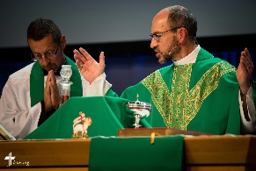
Helps
congregations
call
church workers

Slide 4
Helps to plant new
missions, supports
current missions,
and helps older
congregations
revitalize

Slide 5
Supports campus ministries
Promotes and supports Lutheran education

Slide 6
Prays regularly for every congregation and ministry of the English District

Slide 7
Manages the District’s Endowment Fund that:
* Lowers church worker student debt
* Starts new ministries
* Provides scholarships for church workers
* Supports mission work
* Provides human care and disaster relief

Slide 8
What can we do for our district?

Slide 9
Pray for the ministries throughout the district,
our Bishop,
and his staff.

Slide 10
Attend and support the online Gala on June 12, 2022 at 7:30 p.m. Eastern.

Slide 11
Support the work
of the district with a
congregational budget
line item…
English
District
English
District

Slide 12
or a door offering,
or a fund raiser.

Slide 13
Support the 1+1+1 Mission Initiative by having a 1+1+1 collection box at your church. (1 dollar from each member every week)

Slide 14
Thank You
For being a congregation of the English District as we strive together to proclaim the message of God’s love and forgiveness!

